Slide 1
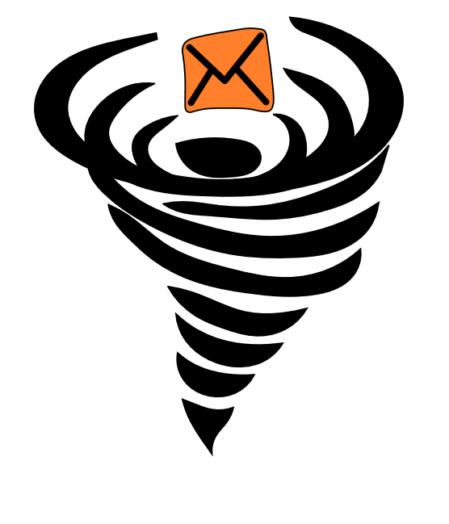
MessageVortex
Unlinkable, censorship-resistant communication

Slide 2
Some catchy intro
Anon.penet.fi ?
Chinese great wall

Slide 3
Content
Predecessor Systems
Anonymity Technologies
What are the problems?
MessageVortex
Why do we need it
What are the problems
How does it work
The General Idea
The Message
The Peer Key
The Sender Key
The Header
eID
Workspace
The Operations
Routing Strategies
What are its benefits
Any Questions Left?

Slide 4
Predecessor Systems
Remailers (0-III)
Nym Remailers
Cypherpunk
Mixmaster
Mixminion
Onion Routing (SOR, Tor, I2P…)
DHT (Salsa, Tarzan,…)
DC-Nets (Herbivore, Dissent)
Broadcast (Hordes)
Distributed Storages (Freenet,Guntella(2))

Slide 5
Technologies for Anonymity
Distribute data
Across multiple nodes
Hide data
Steganography
Mimicking of traffic (content and size wise)
Side channel transmission
Outcurve censorship measurements
Use modified TCP stacks
Use UDP
…but
Traffic may be observed at any point

Slide 6
What are the Problems?
Technology
A (network) packet is always visible…
everyone may see it.
everyone may analyze it.
everyone may forward(modified or unmodified) or keep it.
If we distribute data, we need to recover enough parts.
It is relatively easy to build something for the lab but most of the approaches (e.g., broadcast based) do not scale.
Juristic
Every jurisdiction applies their own laws
Laws may disagree with each other

Slide 7
MessageVortex Why do we need it?
Anonymity is essential
Without anonymity there is no freedom of speech
Censoring of Anonymity technology happens today
China (blocks Tor, calculate citizen score)
Turkey (VPNs banned, Websites censored)
United Arab Emirates (VPN is illegal for illegal activities ;-))
Iran (Only Government approved VPNs are legal)
Egypt (Website censorship, working on banning VPNs)
And more … (Bahrain, Ethiopia…)
This is not necessarily (officially) used for censorship. It is to…
fight „terrorism.“
fight „state decomposing elements.“
stopping “immoral or anti-religious works.”
Agreement: Censorship exists‘
its use may be questionable

Slide 8
How does it work The general idea
Send anonymous messages across the internet
Unobservable from the outside
Holistic approach piggybacking common protocols (e.g., SMTP, XMPP)
Distrust everyone (…)
Routing nodes learn as little as possible
The routing process is controlled by the builder of the routing block in the message
The routing path is diagnoseable by the builder of the routing block
Messages are sent from node to node in a mix type like system
Resistent to common attacks which are hard to cover

Slide 9
How does it work The general idea (2)
Each node gets a couple of payload blocks
It recombines available payload blocks
Payload block of any message
Outcome may be bigger or smaller depending on the applied operation:
Split or merge block
Encrypt or decrypt block
Add or remove redundancy information
Any payload block may be decoy or true message content!
Even the routing node generating decoy cannot tell decoy from message traffic apart.

Slide 10
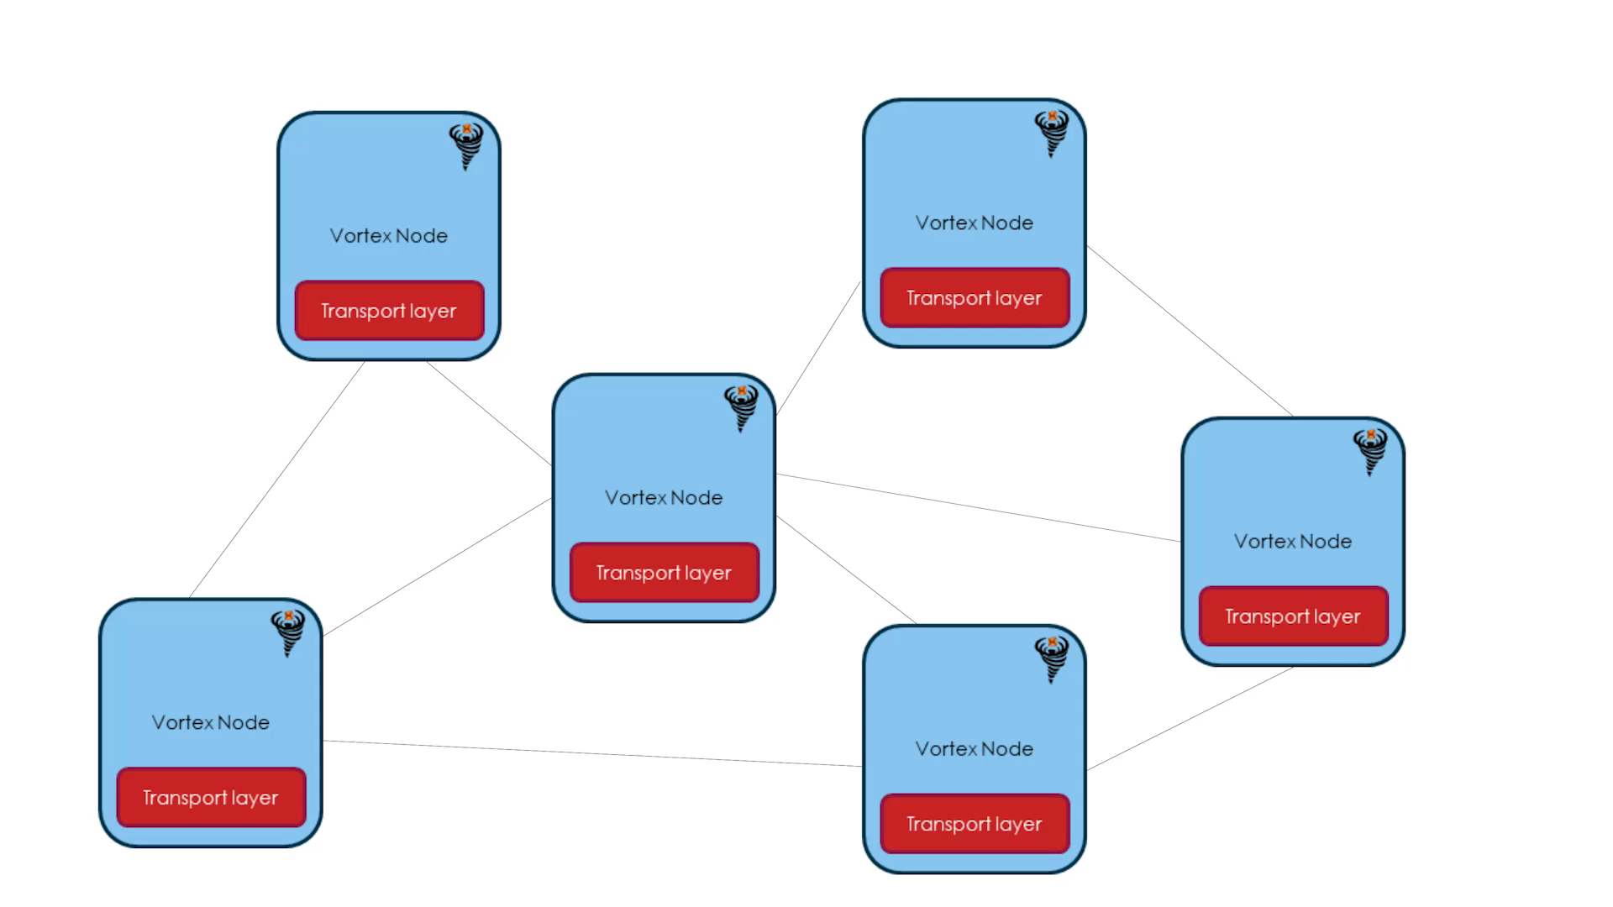
MessageVortex How does it work?
Nodes send and mix messages
All equal
All may be endpoint of a message
All do routing
Hide their traffic in common transport protocols
Messages
Purely controlled by an onionized routing block
Not identifiable unless you possess a node specific key

Slide 11


MessageVortex How does a message look like (on the transport layer)?
Dear sir
This is an obviously machine generated text with some images. May be a password recovery request, a routing graph, or any other kind of machine generated information.
Yours
MessageVortex
Extract
(e.g., „F5“ or similar steganographic algorithm)

Slide 12
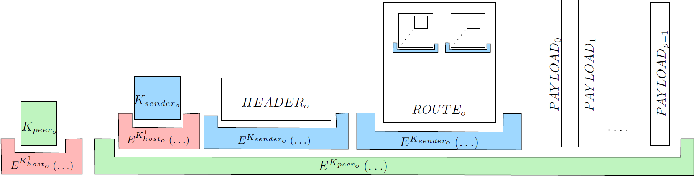
MessageVortex How does a message look like?
Encrypted sender key
Encrypted peer key
The sender key protects the vital blocks
One to many message payloads (parts of the message or decoy)
The peer key protects the „inner message“
Header block „identifying“ the sender and containing requests (short term pseuydonym)
Onionized routing blocks containing information on how to route and mix the message

Slide 13


MessageVortex The peer key
Important side note: The sending node does not(need to) have the receiving nodes public key
The peer key was also included in the message build instructions (in the routing block) of the sending node
The peer key is encrypted with the receiving nodes public key
Reminder: The peer key protects what we call the inner message
The peer key is only known to the two peering partners and the RBB
(sending) VortexNode
(other) VortexNode
Transport layer
Transport layer
VortexNode
(receiving) VortexNode
The RBB is the creator of the routing block
Transport layer
Transport layer
Routing Block Builder (RBB)

Slide 14
MessageVortex The sender key
The sender key is encrypted with the receiving nodes public key
Reminder: The sender key protects the header and the routing block additionally. Otherwise, the sending peer would know its content.
The sender key is only known to the receiving node and the RBB
(sending) VortexNode
(other) VortexNode
Transport layer
Transport layer
VortexNode
(receiving) VortexNode
Transport layer
Transport layer
Routing Block Builder (RBB)

Slide 15
MessageVortex The Header
Contains:
An „ephemeral ID“ (eID; public key; synonymous to the sender)
A serial (allows replay protection)
Validity interval
May contain:
Requests (and the reply block)
Proof of work (if requesting something)
Important:
The header block is signed by the eID

Slide 16
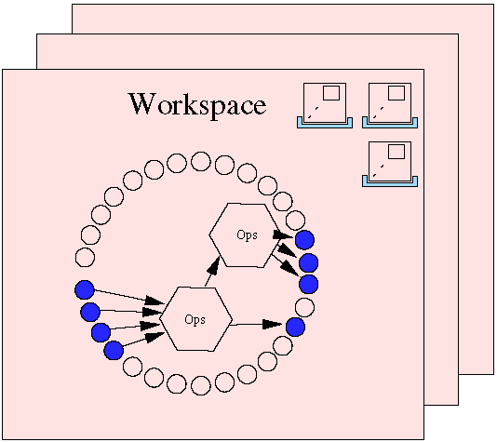
MessageVortex What is an eID? What is a workspace?
An eID is a short term synonym for the sender
A sender must request eIDs on each node (with a request) prior to sending messages with payload
A sender may require solve a crypto puzzle to get an eID
An eID enables a sender to have a temporary, exclusively assigned storage on the node called „workspace“
Each eID has a quota assigned
Maximum number of inbound messages with payload
Maximum number of outbound bytes of messages with payload
A workspace is…
For one eID
Contains
Routing blocks/combos
Operations
Payload blocks (referenced by IDs)

Slide 17
MessageVortex What are the available operations?
Each operation is defined by input Ids and output Ids
We have three types of operations (always a tuple)
Split/Merge a payload
Encrypt/Decrypt a payload
addRedundancy and removeRedundancy
Pay
Payload
S
load
M
Payload
Payload
E
„&+/WSGJ
D
Payload
Payload
R
M e a u P o
R⁻¹
Payload
o n s a a
r t t y d
e r h j l
This is where the magic happens

Slide 18
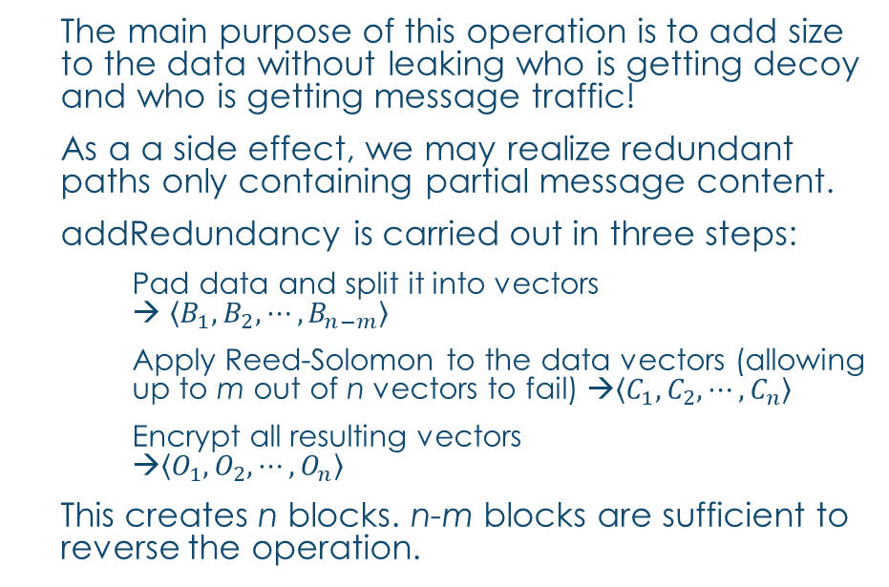
MessageVortex The addRedundancy operation (1)
The main purpose of this operation is to add size to the data without leaking who is getting decoy and who is getting message traffic!
As a a side effect, we may realize redundant paths only containing partial message content.
addRedundancy is carried out in three steps:
Pad data and split it into vectors → $\left\langle B_{1}, B_{2}, ⋯, B_{n−m}\right\rangle$
Apply Reed-Solomon to the data vectors (allowing up to m out of n vectors to fail) →$\left\langle C_{1}, C_{2}, ⋯, C_{n}\right\rangle$
Encrypt all resulting vectors →$\left\langle O_{1}, O_{2}, ⋯, O_{n}\right\rangle$
This creates n blocks. n-m blocks are sufficient to reverse the operation.

Slide 19
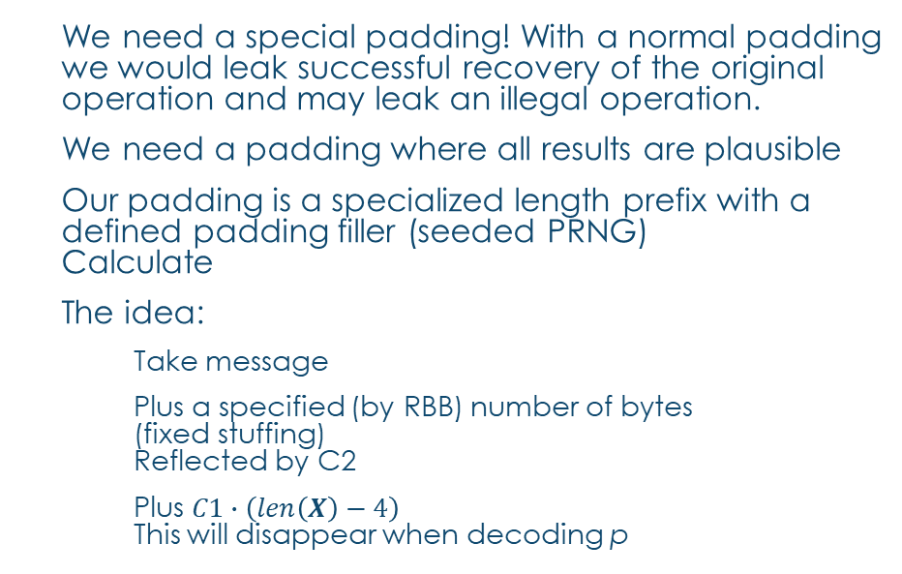

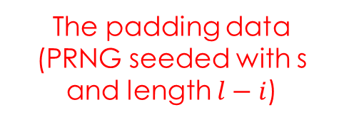
MessageVortex The addRedundancy operation (2)
We need a special padding! With a normal padding we would leak successful recovery of the original operation and may leak an illegal operation.
We need a padding where all results are plausible
Our padding is a specialized length prefix with a defined padding filler (seeded PRNG) Calculate
The idea:
Take message
Plus a specified (by RBB) number of bytes (fixed stuffing) Reflected by C2
Plus $C1∙\left(len\left(X\right)−4\right)$ This will disappear when decoding p
$$i=len\left(M\right)$$
$$e=blocksize\left(E^{K}\right)∙n$$
$$l= \left\lceil \frac{i+C2}{e}\right\rceil ∙e$$
$$p=i+ \left(C1∙l \left(mod \left\lfloor \frac{2^{32}−1−i}{l}\right\rfloor ∙l\right)\right)$$
$$X= \left\langle p,M, R\left(s,l−i\right)\right\rangle$$
The padded message
The padding value (length)
The padding data (PRNG seeded with s and length $l−i$)
The message

Slide 20

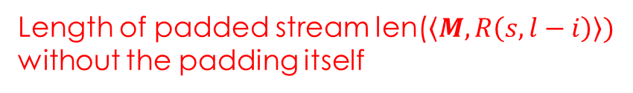
MessageVortex The addRedundancy operation (3)
$$i=len\left(M\right)$$
$$e=blocksize\left(E^{K}\right)∙n$$
$$l= \left\lceil \frac{i+C2}{e}\right\rceil ∙e$$
$$p=i+ \left(C1∙l \left(mod \left\lfloor \frac{2^{32}−1−i}{l}\right\rfloor ∙l\right)\right)$$
$$X = \left\langle p,M, R\left(s,l−i\right)\right\rangle$$
$=\left\langle p,M, R\left(s,p mod (len(X)−4\right)\right\rangle$
The length of the original message
Block size of the operation (dependent on the number of stripes and the cipher block size)
Length of padded stream len($\left\langle M, R\left(s,l−i\right)\right\rangle )$ without the padding itself

Slide 21

MessageVortex The addRedundancy operation (3)
$$i=len\left(M\right)$$
$$e=blocksize\left(E^{K}\right)∙n$$
$$l= \left\lceil \frac{i+C2}{e}\right\rceil ∙e$$
$$p=i+ \left(C1∙l \left(mod \left\lfloor \frac{2^{32}−1−i}{l}\right\rfloor ∙l\right)\right)$$
$$X= \left\langle p,M, R\left(s,l−i\right)\right\rangle =\left\langle p,M, R\left(s,p mod (len(X)−4\right)\right\rangle$$
C2 is a fixed value of bytes to be added to the message. Guarantees that any p<=len(X) is valid
C1 generates a multiple of l.
Guarantees that any p>len(X) is valid as well
C1 and C2 are only required if the padding value is verified. They are NOT required for successful decoding.

Slide 22
MessageVortex The addRedundancy operation (4)
Up until now we have padded the message with the following properties:
The messagehas a perfect length to allow:
Apply the Read-Solomon operation without further padding
Apply the encryption without further padding
→ Let‘s apply Reed-Solomon
Interlude: Reed Solomon (RS) is a code used typically for error correction. It adds a constant but selectable ammount of error correction information to the data, allowing m out of n data chunks to fail.
RS in real world is typically used in a stripped manner in RAID6 systems to allow multiple disks to fail without loosing.

Slide 23
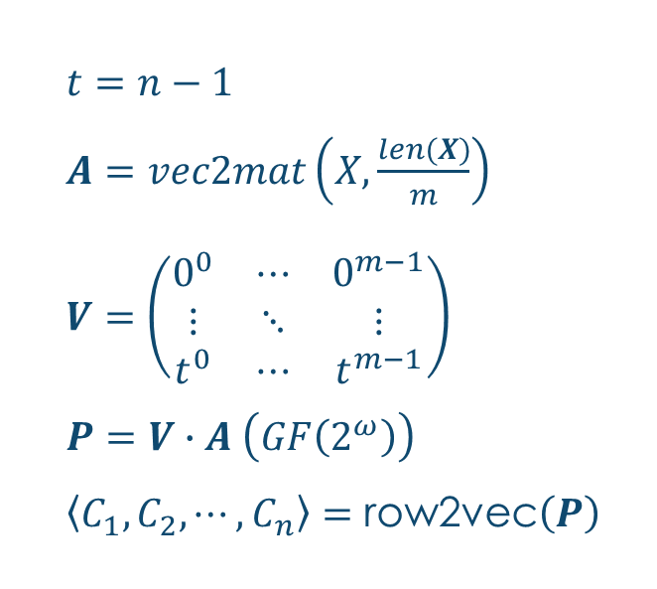
MessageVortex The addRedundancy operation (5)
$t=n−1$
$A=vec2mat\left(X,\frac{len(X)}{m}\right)$
$V=\left(\begin{matrix}0^{0} & ⋯ & 0^{m−1} \\ ⋮ & ⋱ & ⋮ \\ t^{0} & ⋯ & t^{m−1}\end{matrix}\right)$
$P=V∙A \left(GF\left(2^{ω}\right)\right)$
$\left\langle C_{1}, C_{2}, ⋯, C_{n}\right\rangle =\text{row}\text{2}\text{ve}\text{c}\left(P\right)$
We allign the padded data in a matrix
We prepare a suitable Vandermonde matrix (m rows and n colums)
We apply RS The result is a matrix with the message and added redundancy information.
We extract the rows as vector

Slide 24
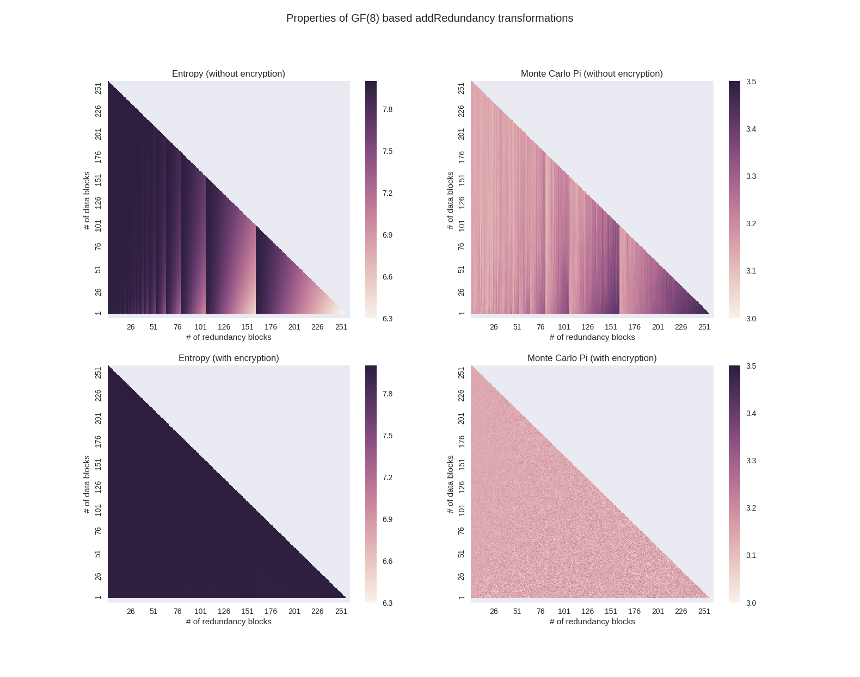
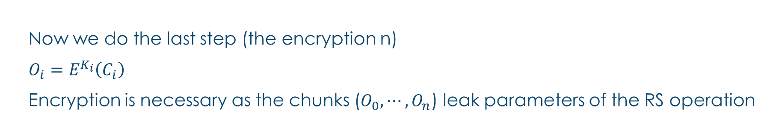
MessageVortex The addRedundancy operation (5)
Now we do the last step (the encryption n)
$O_{i}=E^{K_{i}}\left(C_{i}\right)$
Encryption is necessary as the chunks ($O_{0},⋯, O_{n}$) leak parameters of the RS operation
Entropy and Monte Carlo PI without encryption with varying parameters on the same block WITHOUT encryption
Entropy and Monte Carlo PI without encryption with varying parameters on the same block WITH encryption

Slide 25
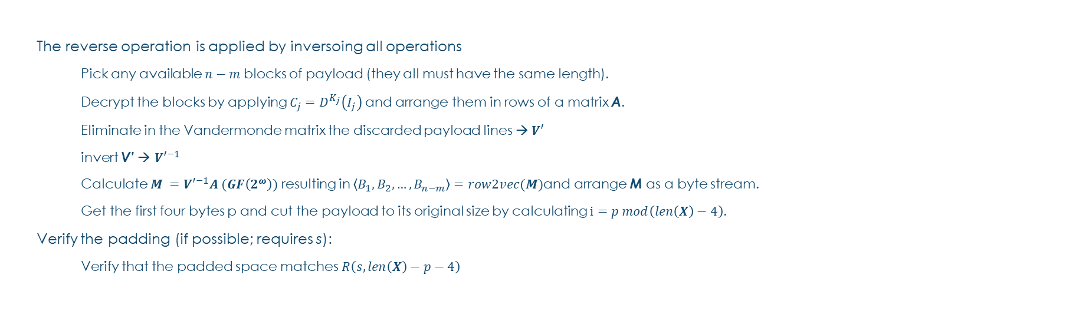

MessageVortex The addRedundancy operation (6)
$$X= \left\langle p,M, R\left(s,p mod (len(X)−4\right)\right\rangle$$
The reverse operation is applied by inversoing all operations
Pick any available $n−m$ blocks of payload (they all must have the same length).
Decrypt the blocks by applying $C_{j}=D^{K_{j}}\left(I_{j}\right)$ and arrange them in rows of a matrix A.
Eliminate in the Vandermonde matrix the discarded payload lines → $V′$
invert V’ → ${V′}^{−1}$
Calculate $M ={V′}^{−1}A (GF\left(2^{ω}\right))$ resulting in $\left\langle B_{1}, B_{2}, …, B_{n−m}\right\rangle =row2vec(M)$and arrange M as a byte stream.
Get the first four bytes p and cut the payload to its original size by calculating $i=p mod\left(len\left(X\right)−4\right)$.
Verify the padding (if possible; requires s):
Verify that the padded space matches $R\left(s,len\left(X\right)−p−4\right)$

Slide 26
MessageVortex Routing Strategies
In General:
Use addRedundancy to add decoy
Use either encrypt or decrypt to onionize
Use Split and merge to join/distribute traffic (requires onionizing or addRedundancy step)

Slide 27
Addon SLides

Slide 28
Comparing MessageVortex MV (Mimicking) compared to a type-0 remailer
MessageVortex
+ Steganogragphically secured transport
+ Protocol agnostic
Only MV as endpoints
Higher complexity
Higher transport overhead
Type-0 Remailer
+ Simple implementation
Easily observable
Requires internet infrastructure
Common
Anonymity breakable by router

Slide 29
Comparing MessageVortex MV (Mimicking) compared to a type-0 remailer (Nym)
MessageVortex
+ Steganogragphically secured transport
+ Protocol agnostic
Higher complexity
Higher transport overhead
Type-0 Remailer
+ Simple implementation
+ No dedicated Transport protocol
Easily observable
Requires internet infrastructure
Common
+ No dedicated transport protocol
Anonymity breakable by router

Slide 30
Comparing MessageVortex MV (Mimicking) compared to a type-1 remailer (Cypherpunk)
MessageVortex
+ Steganogragphically secured transport
+ Protocol agnostic
Only MV as endpoints
Higher complexity
Higher transport overhead
Type-1 Remailer
+ Simple implementation
+ No dedicated Transport protocol
+ Recipient may be any Email-Address
Easily observable
Requires internet infrastructure
Common
+ No dedicated anonymity protocol
Anonymity breakable by router

Slide 31
Comparing MessageVortex MV (Mimicking) compared to a type-2 remailer (Mixmaster)
MessageVortex
+ Steganogragphically secured transport
+ Protocol agnostic
+ Unobservable message size
Higher complexity
Higher transport overhead
Type-2 Remailer
+ Simple implementation
+ Constant message size
+ No dedicated Transport protocol
Dedicated protocol
Requires internet infrastructure
Messages identifiable as PGP encrypted
Common
+ Multiple message paths possible for chunks

Slide 32
Comparing MessageVortex MV (Mimicking) compared to a type-3 remailer (Mixmaster)
MessageVortex
+ Steganogragphically secured transport
+ Protocol agnostic
+ Unobservable message size
Higher complexity
Higher transport overhead
Type-3 Remailer
+ Simple implementation
+ Constant message size
Dedicated protocol
Requires internet infrastructure
Common
+ Multiple message paths possible for chunks

